Slide 1
Aquifer Storage Recharge
Justin & David

Slide 2
Situation
40 000 m^3 in August & July
10<Kh<50 [m/d]
20m
Salt = 30g/l

Slide 3
Time planning
Divided work that needs to be done | Amount of time need to put in per person | Finished before | Planned working days
Literature search | 16 hours | 22/Dec | 20 and 21 December
Design ASR system | 16 hours | 10/Jan | 08/Jan
Producing schedule for injection, extraction and storage | 8 hours | 11/Jan | 10/Jan
Reduce waste of injected drinking water | 8 hours | 18/Jan | 12/Jan
Apply guidelines for injection pressure and maximum velocity | 8 hours | 22/Jan | 18/Jan
Run model for 10 years with a start-up year and less extracted volume | 8 hours | 24/Jan | 22/Jan
Making conclusion and finish report | 8 hours | 25/Jan | 24/Jan

Slide 4
Literature search
Comparable systems
Good practice
Idea of feasibility
Rules of thumb
Choose location?
Get guidelines for injection pressure

Slide 5
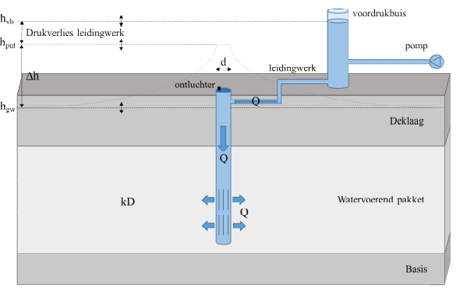

Maximum infiltration rate
Infiltration
Follows from maximum infiltration pressure:
(De Glee)
k = hydraulic conducitivity of aquifer (m/d)
D = thickness of aquifer (m)
c = hydraulic resistance of confining layer (d)
r_{well} = well radius (m)
h_{in} = infiltration head (m + land surface)
h₀ = natural hydraulic head in aquifer (m + land surface)
In practice: decreases due to gradual well clogging
$$Q_{in}=\frac{2πkD\left(h_{in}−h_{o}\right)}{\ln\left(\frac{\sqrt{kDc}}{r_{well}}\right)}$$
h_{in}
h₀
Van Dooren et al. (2020): https://library.kwrwater.nl/publication/61802381/

Slide 6
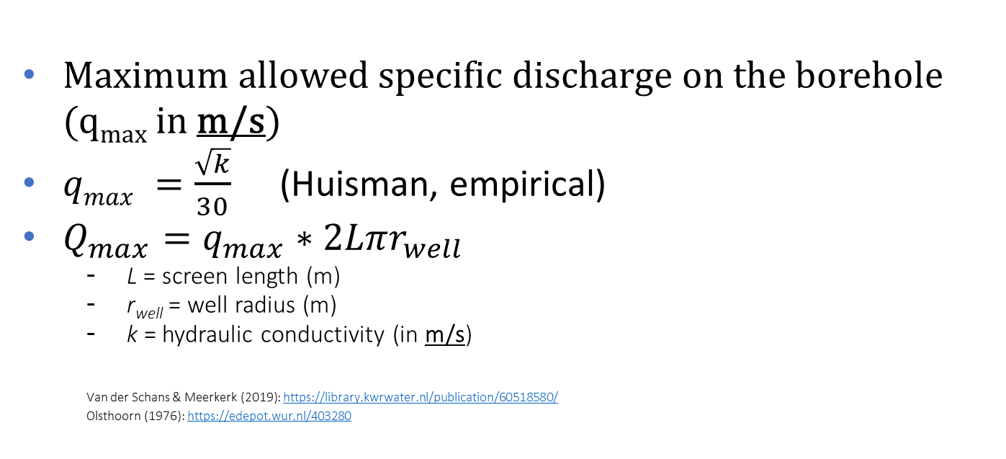
Particle mobilization
Extraction
Maximum allowed specific discharge on the borehole (q_{max} in m/s)
$qmax =\frac{\sqrt{k}}{30}$ (Huisman, empirical)
$Q_{max}=q_{max}∗2Lπr_{well}$
L = screen length (m)
r_{well} = well radius (m)
k = hydraulic conductivity (in m/s)
Van der Schans & Meerkerk (2019): https://library.kwrwater.nl/publication/60518580/
Olsthoorn (1976): https://edepot.wur.nl/403280

Slide 7
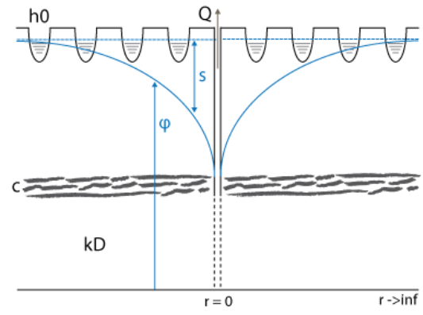
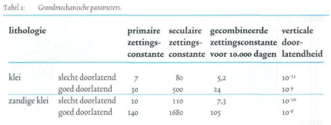
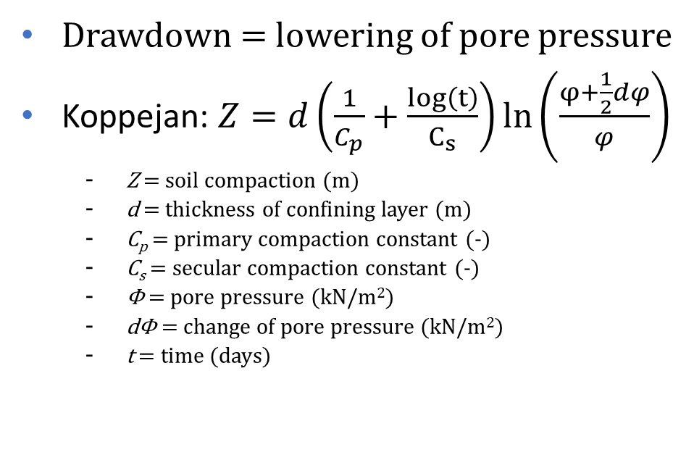
Soil compaction ‘zetting’ (in Dutch)
Extraction
Drawdown = lowering of pore pressure
Koppejan: $Z=d\left(\frac{1}{C_{p}}+\frac{log\left(t\right)}{C_{s}}\right)ln\left(\frac{φ+\frac{1}{2}dφ}{φ}\right)$
Z = soil compaction (m)
d = thickness of confining layer (m)
C_{p} = primary compaction constant (-)
C_{s} = secular compaction constant (-)
Φ = pore pressure (kN/m²)
dΦ = change of pore pressure (kN/m²)
t = time (days)
http://www.grondwaterformules.nl/index.php/formules/onttrekking/deklaag-zonder-rand-de-glee
Drijver (2002): https://edepot.wur.nl/358642

Slide 8
Design ASR system
MODFLOW6 model
Adjust parameters
Background flow?
Optimise model to reduce waste
Ensure guidelines for injection pressure and maximum velocity are met
Run model for 10 years with a start-up year and less extracted volume

Slide 9
Producing schedule for injection, extraction and storage
Injection
Analysis of when water excess
Extraction
Water deficit – July & august:
Schedule for 1 year & 10 years
Storage possibly above ground if pumping rate too low

Slide 10
Report
Discuss the uncertainties in your design.
Changes in Kh
Scenarios?
Present findings

